Slide 1

Smart Glasses with Voice Assistance and GPS for Independent Mobility of the Blind People
Batch : 08
Presented By:
Ch Manohar : 21761A4211
B V N Durga Vinay : 21761A4204
B Surendra Babu : 2176A4208
T Gopikanth : 21761A4221
Under Guidance of :
Faculty Name
DEPARTMENT OF COMPUTER SCIENCE & ENGINEERING (AI&ML)
LAKIREDDY BALI REDDY COLLEGE OF ENGINEERING
(AUTONOMOUS)
L.B.Reddy Nagar :: Mylavaram – 521 230 :: NTR Dist.:: A.P.

Slide 2
Contents
Abstract
Objective
Scope
Problem Statement
Basic Concept
Literature Survey
Draw Backs in Existing System
Proposed System
Methodology
Algorithm
Dataset
Implementation
Results
Conclusion
Future Work
References
Details of Journal Paper

Slide 3
Abstract
Smart glasses with integrated voice assistance, GPS, and obstacle detection enable visually impaired individuals to navigate confidently and safely. The glasses provide real-time audio navigation, contextual information for diverse environments, and alerts for nearby hazards. GPS ensures precise location tracking. This wearable technology enhances autonomy, reduces dependence on external help, and represents a transformative leap in assistive technology, significantly improving quality of life and mobility for visually impaired users.
Keywords: Integrated voice assistance, Object Detection, Audio navigation, Obstacle detection, GPS tracking, Speech Recognition, OCR Detection, Text to Speech Conversion

Slide 4
Objective
To develop an innovative smart glasses solution that enhances mobility and independence for visually impaired individuals by providing:
Real-time Audio Navigation: Clear directional guidance for seamless movement.
Obstacle Detection & Alerts: Immediate hazard identification to ensure safety.
GPS Tracking: Real-time location tracking to monitor user movement accurately.
Contextual Environment Information: Voice-assisted descriptions of surroundings for better situational awareness.
Speech Recognition & OCR: Enable text reading and interaction with visual content through text-to-speech conversion.
This project aims to improve autonomy and reduce reliance on external assistance, fostering confidence and enhancing the overall quality of life.

Slide 5
Scope
Target Users: Visually impaired individuals seeking enhanced mobility and independence.
Core Features:
Object Detection: Real-time identification of nearby hazards.
OCR (Optical Character Recognition): Reading and converting text to speech.
GPS Tracking: Real-time user location monitoring.
Audio Feedback: Contextual information and alerts for safety.
Technology Stack: Generative AI, IoT, Machine Learning, Deep Learning, and GPS integration.
Future Enhancements: Expansion into facial recognition, indoor/outdoor navigation, and multilingual support.
Impact: Empower users with greater mobility, self-reliance, and confidence in daily activities.

Slide 6
Problem Statement
Visually impaired individuals face significant challenges in navigating unfamiliar environments, identifying obstacles, and reading text, which often leads to reduced mobility and increased dependence on external assistance. Traditional aids, such as canes and guide dogs, offer limited functionality and fail to provide comprehensive environmental awareness or real-time feedback. Many technological solutions also lack continuous hazard detection, contextual information, and speech-based navigation, essential for safety and independence. This project aims to bridge these gaps by developing smart glasses with real-time audio guidance, obstacle detection, OCR-based text reading, and GPS tracking. By enhancing situational awareness and offering immediate feedback, the solution seeks to empower visually impaired users with greater mobility, safety, and self-reliance, improving their overall quality of life.

Slide 7
Basic Concept
The project focuses on developing smart glasses designed to assist visually impaired individuals by providing:
Real-time Audio Navigation: Voice-guided instructions for safe mobility.
Obstacle Detection: Immediate alerts for hazards to ensure safety.
OCR (Optical Character Recognition): Converts printed or digital text into speech for text reading.
GPS Tracking: Monitors the user’s location to enhance situational awareness.
By integrating speech recognition, machine learning, and IoT technologies, the glasses aim to enhance mobility, safety, and independence for visually impaired users in diverse environments.

Slide 8
Literature Survey
S.No | Title of the Paper | Authors | Technologies
1. | Design and Implementation of the Smart Glasses for Blind People – Using Raspberry PI | Rotimi Abayomi | Obstacle Detection, Object Identification, Vibration Motor, User Tracking
2. | Smart Glasses for the Visually Impaired People | Maghfirah Ali Tong Boon Tang | Text recognition, OCR, Braille reader
3. | An innovative smart glass for blind people using artificial intelligence | Shantappa G. Gollagi, Kalyan Bamane, Dipali Manish Patil,Sanjay B. Ankali | Text to Speech, Obstacle detection, OCR, Object Detection
4. | Real-Time Object Detection Application for Visually Impaired People: Third Eye | Selman Tosun, Enis Karaarslan | Camera Module,Android app, ML, Image Processing, Voice Assistance
5. | Intelligent Smart Glass for Visually Impaired Using Deep Learning Machine Vision Techniques and Robot Operating System(ROS), | Aswath Suresh , Chetan Arora , Debrup Laha , Dhruv Gaba | UltraSonic sensor, Raspberry Pi, ROS, Obstacle Detection

Slide 9
Draw Backs in Existing System
Limited Obstacle Detection: The system struggles to detect certain obstacles like flying objects, staircases, and potholes, making navigation incomplete in various real-world scenarios​.
Computational Constraints: The Raspberry Pi’s computing capacity is limited, which affects real-time image processing and object detection performance. A more powerful hardware solution with a better GPU or TPU is required for smoother operations​​.
Slow Frame Rates: The camera's frame rate ranges between 0.5 to 4.5 frames per second, which is too slow for reliable real-time navigation assistance, particularly for detecting moving objects​.
Hardware reliability issues, such as the SD card holder breaking and rapid overheating of the Pi camera, were encountered​.
Complex Power Supply Requirements: Scaling down the current to an adequate level for the Raspberry Pi proved challenging, which further complicated the implementation​.

Slide 10
Proposed System
This research focuses on advanced smart glasses for visually impaired individuals, integrating voice assistance, GPS tracking, and real-time obstacle detection to enhance mobility and independence. The glasses provide audio-based guidance for safe movement, detect hazards through sensors, and alert users to avoid collisions. GPS tracking offers location awareness, helping users know their position. This technology reduces reliance on external support, offering confidence and safety while moving through complex environments. The study demonstrates a scalable model for integrating multisensory systems into wearables, improving accessibility and quality of life for visually impaired users.

Slide 11
Methodology
1. Hardware Integration
Raspberry Pi processes tasks, while the camera captures visuals for object detection and OCR. Ultrasonic sensors provide obstacle alerts, and Bluetooth earphones offer audio feedback.
2. Software Framework
Obstacle & Object Detection: YOLOv5 and ultrasonic sensors identify hazards and objects, triggering audio alerts.
Voice Assistance & OCR: Processes voice commands and converts text to speech using gTTS for accessibility.
3. GPS Navigation
Provides real-time location tracking with audio guidance for navigation.
4. Mode Switching
Voice commands enable switching between detection modes for hands-free control.
5. System Testing
Tested in real-world settings with user feedback to improve accuracy, speed, and usability.

Slide 12
Algorithm
YOLOv5m (Medium Model):
A pre-trained object detection model that processes real-time camera input to identify and classify objects. The detected objects are communicated to the user via audio feedback for enhanced situational awareness.
Obstacle Detection:
Uses the HC-SR04 ultrasonic sensor to measure distances and trigger real-time audio alerts when obstacles are detected.
OCR (Optical Character Recognition):
Extracts text from captured images and converts it to speech using the gTTS (Google Text-to-Speech) library for text reading assistance.
Speech Recognition:
Processes user commands for intuitive hands-free interaction with the smart glasses.

Slide 13
Dataset
YOLOv5m Pre-trained Model:
Utilizes the model trained on public datasets (e.g., COCO) for object detection, ensuring accurate recognition of various objects. No additional custom datasets are used.
OCR for Text Extraction:
Text is extracted from real-time images captured by the camera and converted to speech using the gTTS (Google Text-to-Speech) library to assist visually impaired users with reading.
Live Camera Input:
The live camera is used to capture real-time video input for both object detection and OCR-based text extraction, enabling dynamic and immediate feedback for the user.

Slide 14
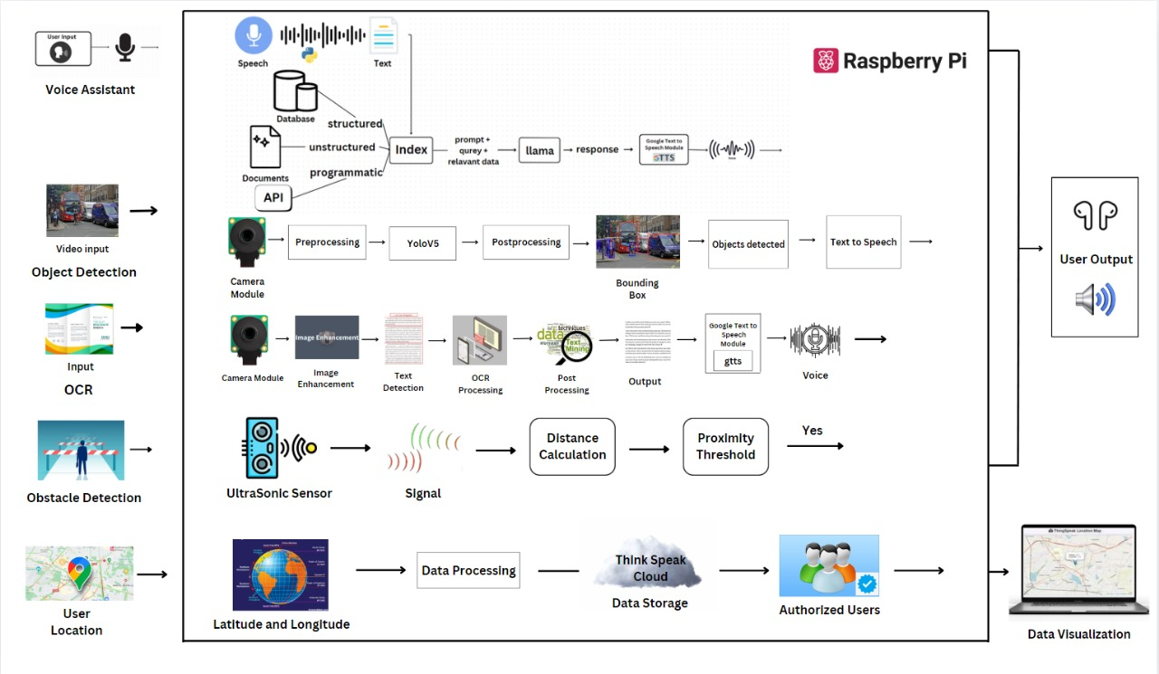
Implementation

Slide 15
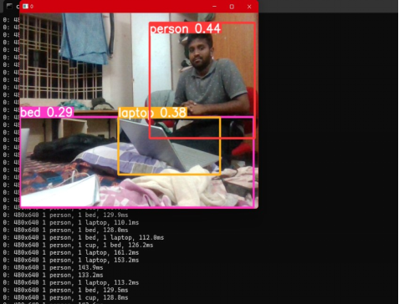
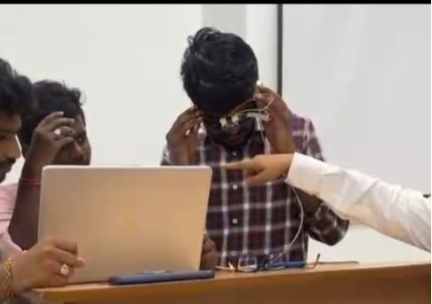
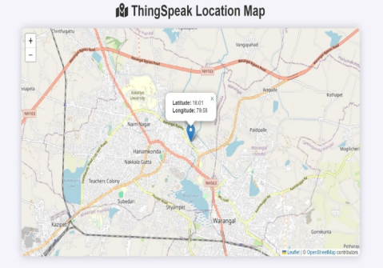
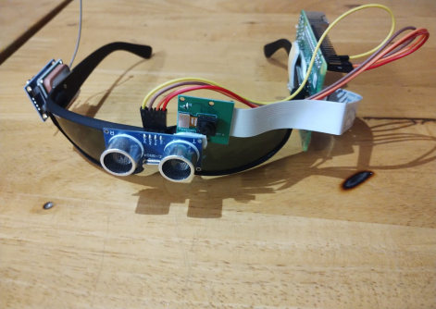
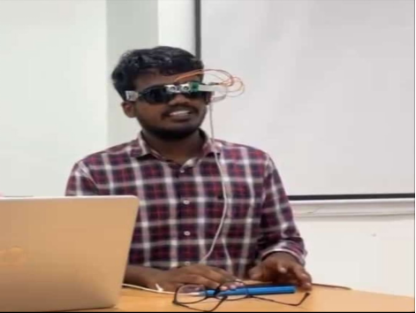
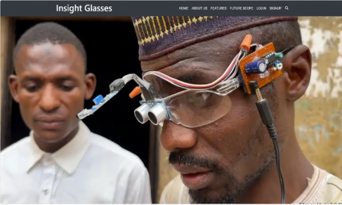
Results
Object Detection
Obstacle Detection
GPS Tracking System
Optical Character Recognition (OCR)
Voice Assistance
User Login and Activity Tracking

Slide 16
Conclusion
The proposed smart glasses harness cutting-edge technologies to address the navigation challenges faced by visually impaired individuals. By integrating YOLOv5m-based object detection, OCR for text reading, speech recognition for hands-free control, and GPS tracking, the system provides real-time situational awareness and adaptive audio feedback. The live camera ensures continuous environmental monitoring, enabling obstacle detection and text extraction on the go. This comprehensive solution enhances safety, mobility, and independence, fostering greater confidence and reducing reliance on external assistance. With future potential for indoor navigation and language support, these smart glasses aim to be a transformative leap in assistive technology for visually impaired users.

Slide 17
Future Work
Advanced Ultrasonic Sensors: Integrate sensors with a 2-meter range for improved obstacle detection.
Real-Time Voice Control: Enable voice commands for hands-free control of the smart glasses.
Video Recording: Add a single-button function for capturing video recordings.
Food Recognition: Use camera technology and AI to identify food items, provide calorie information, and describe them.
Custom Voice Assistance: Offer personalized voice assistance with custom user voice options.
User-Friendly App: Develop an intuitive app for managing settings, receiving updates, and interacting with the smart glasses.
YOLOv10 Object Detection: Implement YOLOv10 for accurate and real-time object detection.
Phone Call Integration: Allow users to make and receive phone calls using voice commands.

Slide 18
References
Navigation Systems for the Blind and Visually Impaired: Past Work, Challenges and Open Problems, https://www.researchgate.net/publication/334897142_Navigation_Systems_for_the_Blind_and_Visually_Impaired_Past_Work_Challenges_and_Open_Problems
2. Intelligent Smart Glass for Visually Impaired Using Deep Learning Machine Vision
Techniques and Robot Operating System (ROS),
https://ieeexplore.ieee.org/document/10307374
3. AI Powered Glasses for Visually Impaired Person,
https://www.researchgate.net/publication/36366
4. IBGS: A Wearable Smart System to Assist Visually Challenged,
https://ieeexplore.ieee.org/abstract/document/9837057,

Slide 19
Details of Journal Paper
Title: Smart Glasses with Voice Assistance and GPS for Independent Mobility of the Blind People
Authors: B V N Durga Vinay, B Surendra Babu, Ch Manohar, T Gopikanth
Journal Name: [Name of the Journal]
Publication Date: [Date of Publication]
Volume/Issue: [Volume and Issue Number]
DOI/Link: [Link or DOI for reference]
Abstract: This paper presents the development of smart glasses designed to assist visually impaired individuals by providing real-time object detection, text extraction through OCR, and hands-free navigation. Leveraging the YOLOv5m model for object detection and live camera feeds, the system aims to enhance user autonomy and improve daily mobility through accurate and intuitive features.
Key Findings: Highlight the most important outcomes or insights from the paper (bullet points).
Relevance: Explain how the paper relates to your project and its significance.

Slide 20
Thank Q

